Slide 1
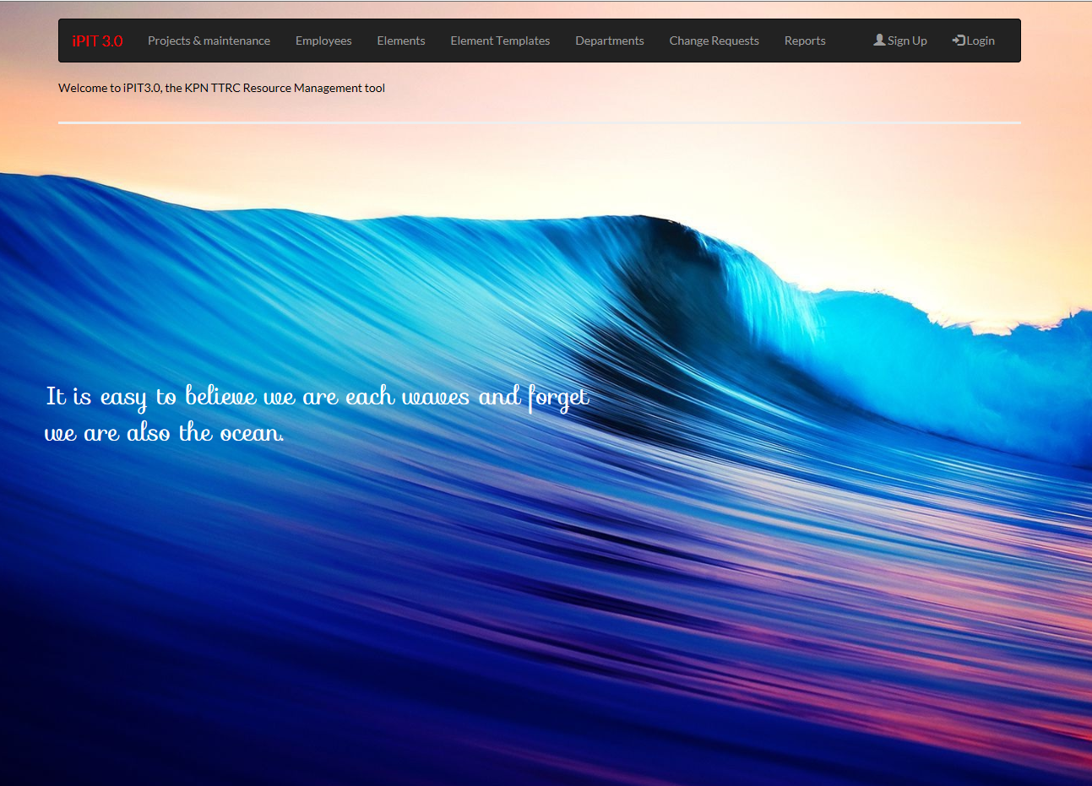
Manual iPIT 3.0
Date 13-09-2017
Presented by: Robert van der Starre, Martin Swaen and Martin Groeneveld

Slide 2
Agenda
About the iPIT tool
Menu structure of the iPIT tool
Login
iPIT 3.0 Manual
Employees
Project and Maintenance
Elements and element templates
Departments
Change Request
Reports
Edit element plan
Resource allocation
Change Resource allocation
Backlog and sprint backlog
Add, change and delete users

Slide 3
About iPIT tool
IPIT is an IT tool used by the department (NIO SP SI&I Test & Implementation and NIO ACN Innovation Integr Del&Impl IM (Mobile part)). Our main role is to work as testers in a test bed (called TTRC) in projects. The (resource) managers need to assign testers to projects and coordinate different projects sharing the same test environment.
Basic function(s) of this tool:
What projects are on-going, what are their statuses?
What are the planned projects?
How much hours do projects ask for the coming weeks?
Who is allocated to which project for how many hours in a certain week.
What machines will be used by a certain project in a certain time?
Register and approve Change Request
Etc

Slide 4
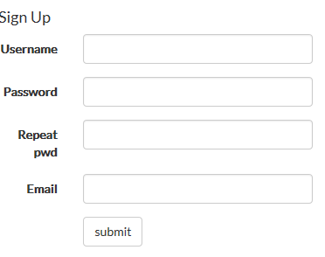


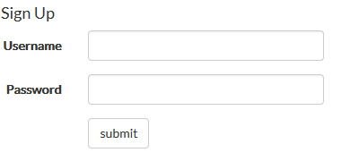



Login
Login and logout
If you don’t have a login account, you can sign up
use the menu button Sign Up.
Now you are signed in as guest.
There are 5 groups in iPIT: admin, human_admin,
element_admin, test_manager, guest
In the main menu you can see the login name and group were you belong to
To change to a other login group, please send a mail to Robert van der Starre, Martin Swaen or Martin Groeneveld they can create an account for you. If applicable.
Go to login in the menu. Here you can sign up
To change your password you can use the Set Password button
If you want to logout please use the logout button.

Slide 5

iPIT manual
In the iPIT tool there is also a manual, you can open it in the main menu
The manual is depending to which group you belong to.

Slide 6

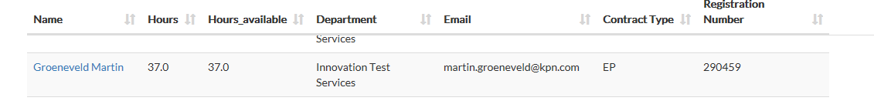
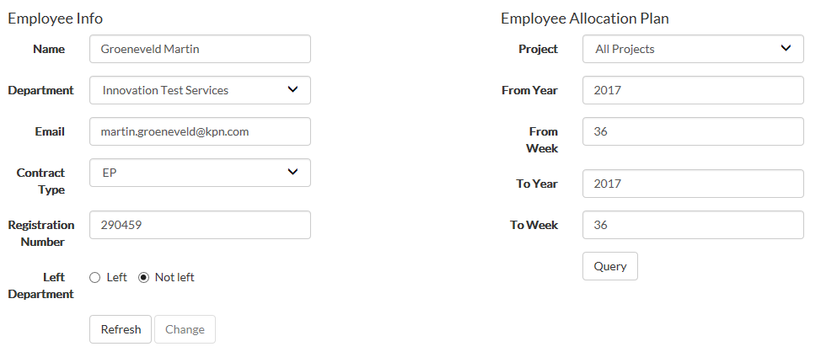
Employees (1)
Only the resource manager and admin can add and delete employees in this iPIT tool.
Press on employees in the main menu, now you see an overview of all the employees known in this iPIT tool.
If you want to see the details from this employee, please click on her of his name.

Slide 7
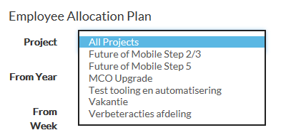
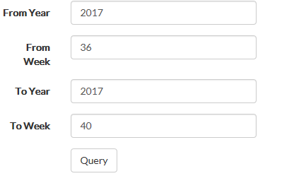
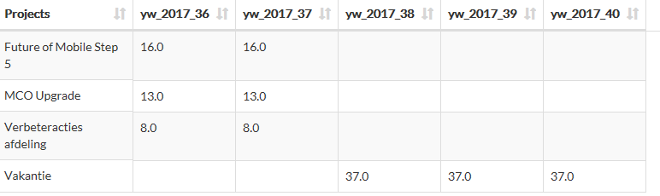
Employees (2)
It’s also possible to see on which projects this employee work(ed) on, pull down project.
To see on which project this employee is working or worked on, it’s also possible to make a report from date (year/week) to date (year/week).
Fill in the year, week and then click on Query, on the
bottom you will see an overview.

Slide 8

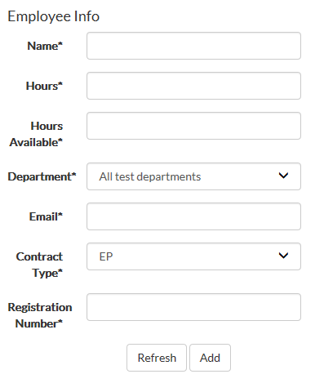
Employees (3)
New employee
The resource manager and admin can add, change or delete a employee. Click on new in the employee menu.
Now you can add a new employee.
Please make sure the email is filled in
correctly, this mail account is used that
the test manager can do changes in
his own projects and elements
allocation
Press on add to add this new employee.

Slide 9
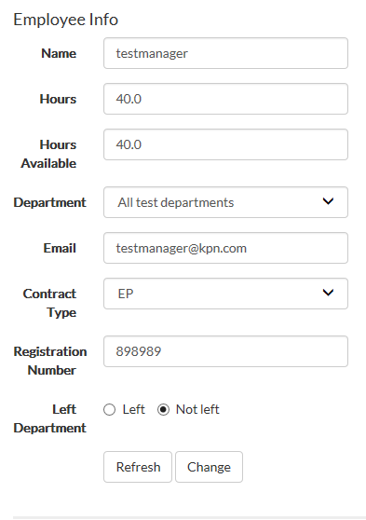


Employees (4)
Change employee info
To change the employee info, press on the name you want to change in the employee menu.
Now you can change this info, to activate this changes click on Change.
If an employee left our department we have to press
on left and then on change. This employee is not
visible any more in the employee overview, but is still
known in the database.

Slide 10

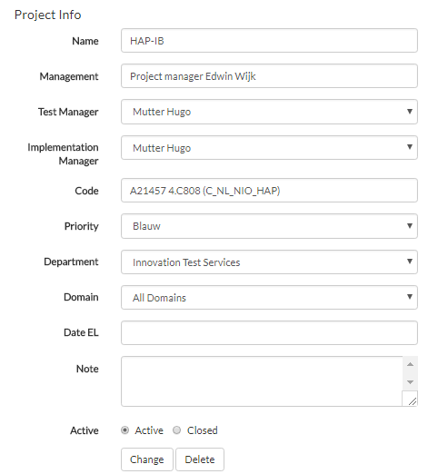


Project & Maintenance (1)
If you want to see all open project, please click on the button project & maintenance.
Here you see an overview of all the open projects, the project/test manager, project code etc.
To see the project details click on the project name
Now you see all the details of this project, only
the assigned test manager, resources manager
and admin can do changes on this project.
Admin and the resource manager can delete a
project.
If the change and/or delete button are high lighted,
you have the right authorization to change/ delete a
project.
Only the resource manager and the admin can
create a new project.

Slide 11
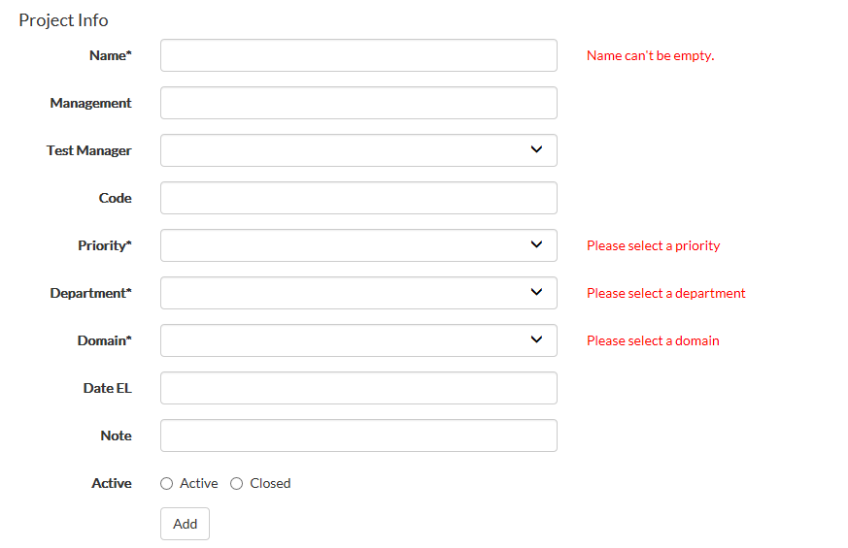
Project & Maintenance (2)
At the bottom of the project & maintenance menu, there is a button the create a new project.
The fields Name, Priority, Department and domain has to be filled in before you can add this project. It’s wise to fill in all the fields if the info is already available.

Slide 12
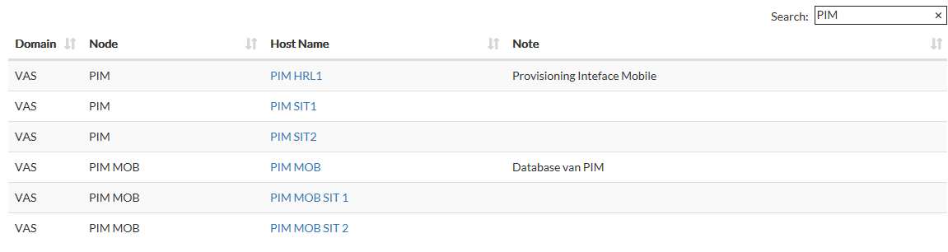
Elements and Element Templates (1)
Only the element_admin and the admin can add, change or delete elements.
If you select elements you will see an overview of al known elements in iPIT. Domain, node, host name and note (info)
To see the element details click on the host name, now you see the details.
It’s also possible to search for a node. Fill in what node you want to find, you will see all node , domain and all the host names that belong to this node.

Slide 13

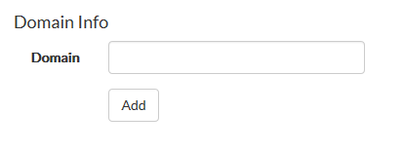
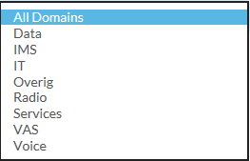
Elements and Element Templates (2)
New domain
For new elements, a new domain can be made, new node and hostname can be added.
New domain, click on the New Domain button (element menu). Here you can add a new domain.
The following domains are already known.

Slide 14

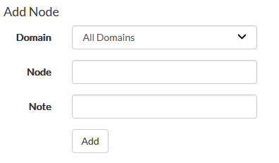
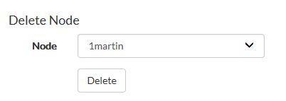

Elements and Element Templates (3)
New node
Add a new node, click on Node Info.
Now you can fill in the domain, node name (element name) and same notes.
In this menu it’s also possible to delete a node.
You can’t delete the node if it’s still connected to
a host name. Then you first have to delete the
host name(s).

Slide 15
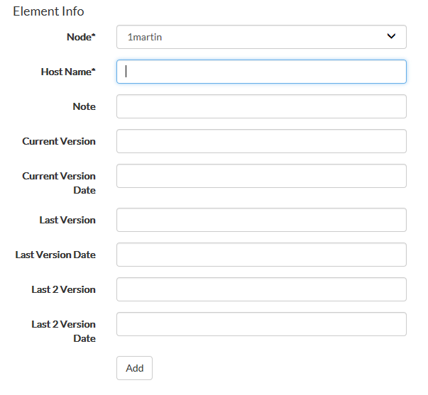
Elements and Element Templates (4)
New node
Add a new element.
Click on the element button in the menu element.
Select the node were you want to
connect your elements (host name).
Also the software versions can de
added.

Slide 16
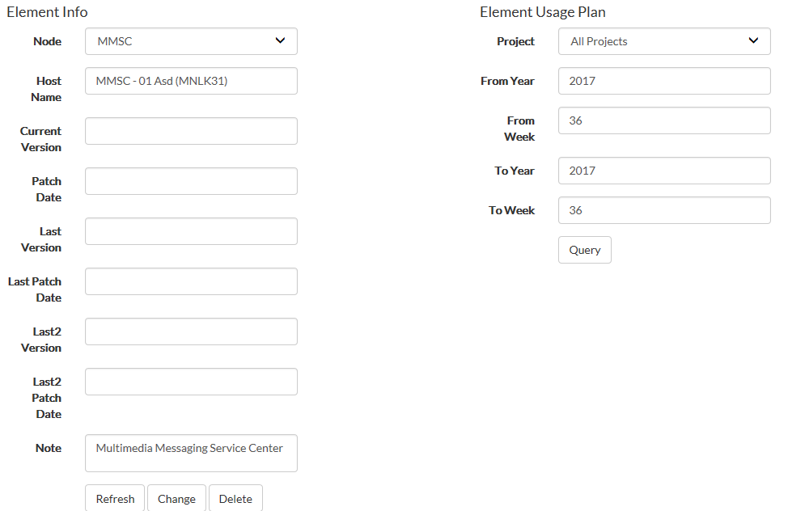
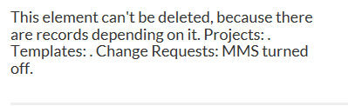
Elements and Element Templates (5)
New node (delete)
Delete or add an element (host name). To delete a host name you have to click on the node details in the element menu.
Press delete if you
want to delete this
element.
If the element is still
registered to a project
or still known in a
change request it’s
not possible to delete
this element.

Slide 17

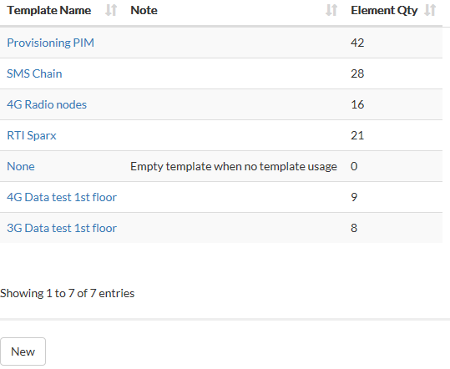
Elements and Element Templates (5)
Element templates
Sometimes it’s easy to make a element template, this will save time if you want to register the element(s) to your project(s).
The element_admin and the admin can add or change a new element. Press on element templates in the main menu.
You will see an overview from the templates that are already known in the iPIT tool.

Slide 18
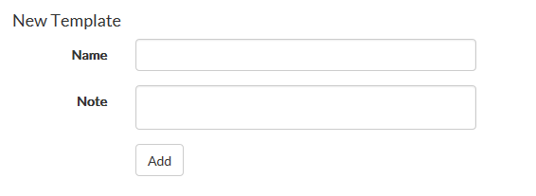
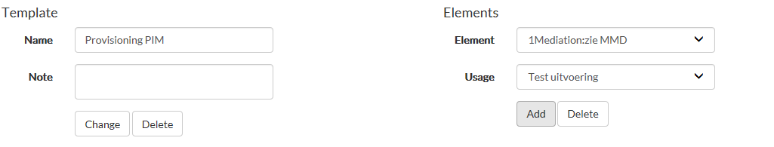

Elements and Element Templates (6)
Element templates
Please fill in this template together with the element manager (Martin Swaen for SP, Fred Boon and Anouska for ACN).
First you have the create a new template name.
To add, change or delete elements in this template you have to click on the template name. Then you can add new elements to this template and change the template name.
On the bottom there is a overview of al the elements known in this element template. Also you can search for a element in this element template.

Slide 19

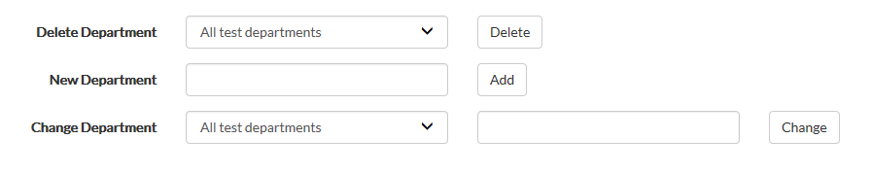
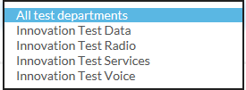
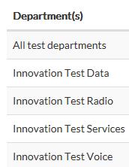
Departments
In the menu departments there is an overview of all the departments known in this iPIT tool.
De resources manager and admin can add, change and delete the departments.
To change or delete a department you have the use the pull down menu
On the bottom you will see the overview of al the departments that are known in the iPIT tool.

Slide 20
Departments
In the menu departments there is an overview of all the department known in this iPIT tool.
De resources manager and admin can add, change and delete the departments.
To change or delete a department you have the use the pull down menu
On the bottom you will see the overview of al the departments that are known in the iPIT tool.

Slide 21

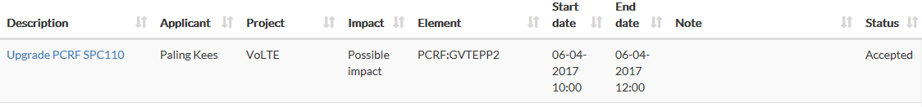
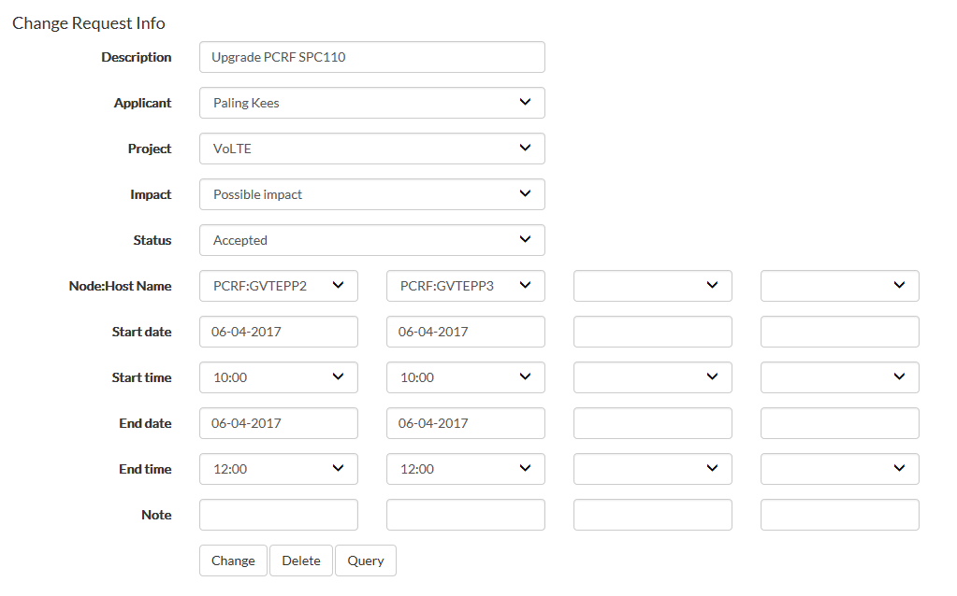
Change request (1)
CR overview
Only the resources manager, test manager and admin can add, change or delete a change request.
If you press the button Change Request (CR) in the main menu, you will see an overview of all the CR’s known in the iPIT tool.
If you want to see the details of one CR, press on the description.
You will see an overview of
which element(s) that will be changed.
What the impact will be: “no”,
“possible” or “impact”. And the
start and end date and time.

Slide 22

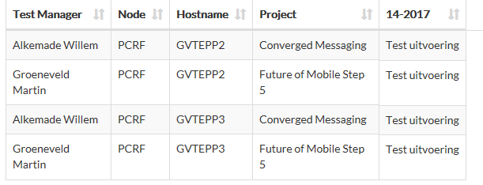
Change request (2)
Query
To see which project are impacted, please click on Query on the bottom you will see the impacted projects, node, hostname , test manager and week number. So we can inform them if necessary.

Slide 23

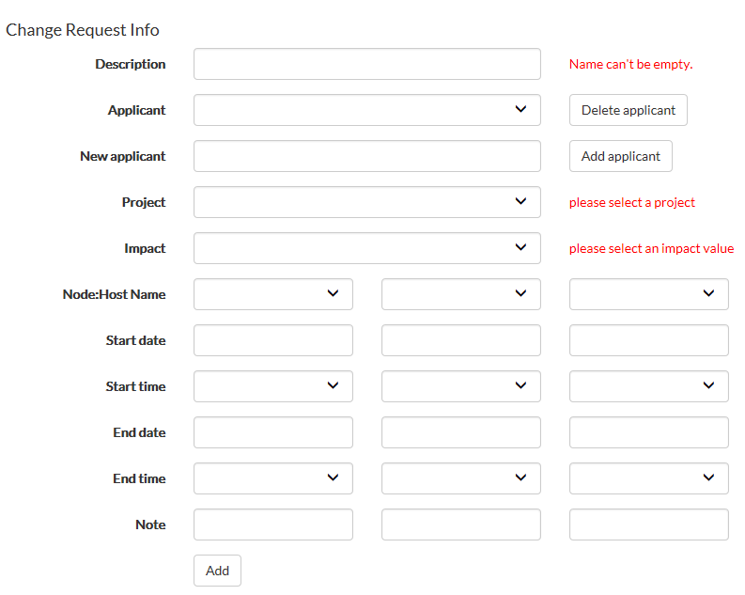


Change request (3)
New CR
To add new CR, click on new in the Change Request menu.
The fields, description, project, impact and
Node: Host name are mandatory.
You have to fill in the description and
applicant via a pull down menu. If the
applicant is not known we can add
her/ him as a new applicant with the
Add applicant button.
Project has to be filled in, if the project is
not known then we have to add this.
Impact have to be filled: “no impact”,
“possible impact” or “impact”.
It’s possible to fill in 4 Node maximal in 1 CR,
via a pull down menu you can select
Node-host/Name.
File in start and end date and time.
If everything is filled in correctly you can add this
change by pressing the Add button.

Slide 24



Change request (4)
Approve , change and delete applicant.
If there are no subjections this CR will be approved. Click on the CR in the Change request menu. Change the status in accepted.
In the same menu you also can change or delete the CR.
If the start date or time, is changed please discuss this with the projects who are using this nodes. Every Monday there is a meeting to discuss the CR’s. If you can’t wait for that please discuss this directly with the test managers for the project who are (possible) impacted.
If the applicant is not valid any more we can delete her/him. This can be done when you are adding a new CR.

Slide 25

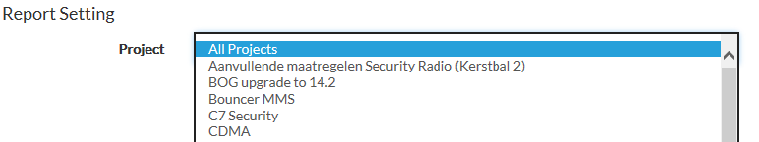
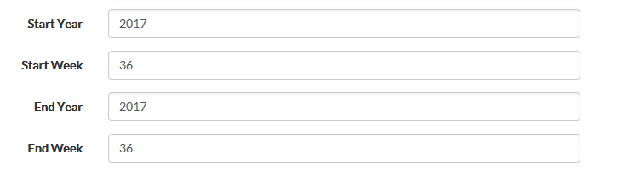
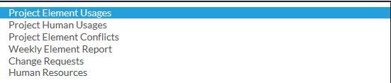

Reports (1)
Overall
It’s possible to make a report for all projects or for a specified project, via pull down menu project.
A report can be made for an certain period, start year/ week to end year/week.
There are different
kind of reports you can
choose from
In every report you can search

Slide 26

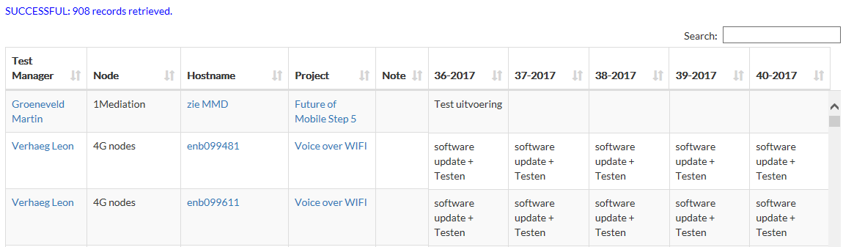

Reports (2)
Project Element Usages
In this report the Project Element Usages is shown over period of time.
You can see how many records there are, overview of the Projects, Test Manager, Hostname and week numbers.
If you click on the test manager you will see the employee info, on project the project info and on Hostname the element info.
It’s also possible to download a report to excell.

Slide 27

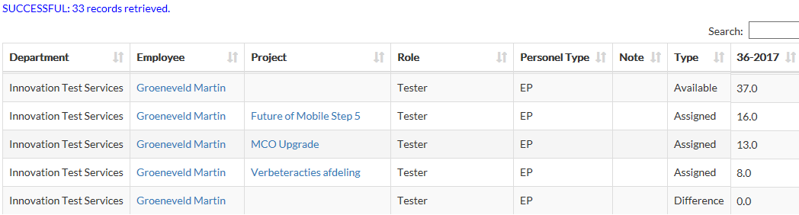
Reports (3)
Project Human Usages
In this report the Project Human Usages is shown over period of time.
You can see how many records there are, overview per employee, available hours, assigned hours to a certain project and the difference hours.
If you click on the employee’s name you will see the employee info and on project the project info.
It’s also possible to download a report to Excel, in Excel you can easily sort, filter and make diagrams.

Slide 28

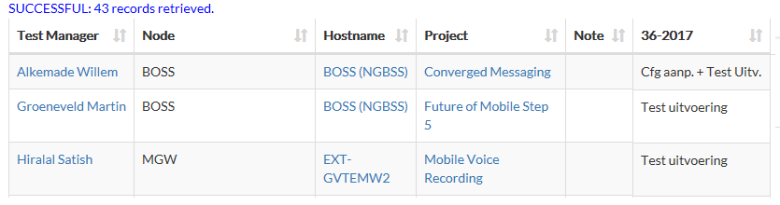
Reports (4)
Project Element Conflicts
In this report the Project Element Conflicts is shown over period of time.
You can see how many records there are, overview of the test manager, used host names and the projects were an conflict can occurs.
If you click on the test manager you will see the employee info, on Hostname the element info and on project the project info.
It’s also possible to download a report to Excel, in Excel you can easily sort, filter and make diagrams.

Slide 29

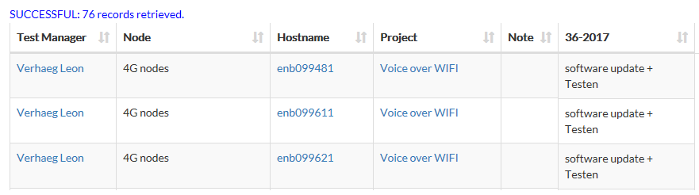
Reports (5)
Weekly Element Report
In this report the Weekly Element Report is shown over period of time.
You can see how many records there are, overview of the test manager is, node, host names and the projects who are using this elements.
If you click on the test manager you will see the employee info, on Hostname the element info and on project the project info.
It’s also possible to download a report to Excel, in Excel you can easily sort, filter and make diagrams.

Slide 30

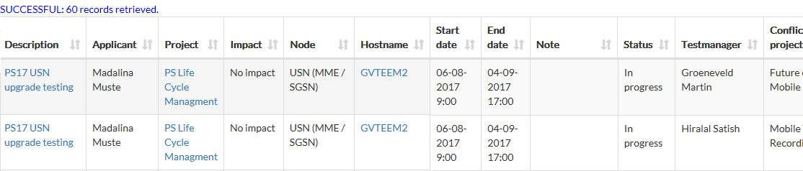
Reports (6)
Change Request (CR)
In this report the Change Request is shown over period of time.
You can see how many records there are, overview of CR description, applicant, project, impact, node, hostname, start/end date end time, the test manager and impacted projects.
If you click on the description you will see change request info, on Hostname the element info and on project the project info.
It’s also possible to download a report to Excel, in Excel you can easily sort, filter and make diagrams.

Slide 31
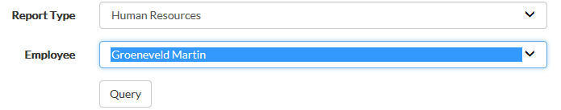

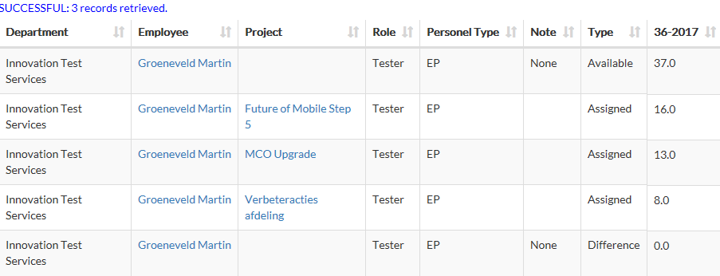
Reports (7)
Human Resources
In this report the Human Resources for 1 employee is shown over period of time.
You can see how many records there are, department, employee, project, role, personal type and the available, assigned and difference hours. It’s also possible to change these hours.
If you click on the employee you will see employee info and on project the project info.
It’s also possible to download a report to Excel, in Excel you can easily sort, filter and make diagrams.

Slide 32
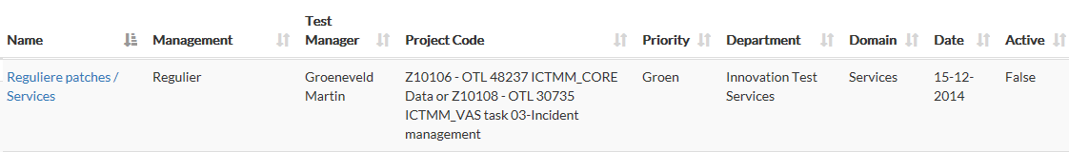
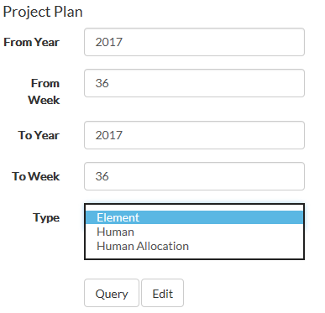
Edit element plan (1)
Only the element manager, admin and the test manager for his own project can change this.
If you want to register your element, you have to go to your project via project & maintenance. And select your project.
To add your used elements, select from week to week and select type element in project plan. Click on edit.

Slide 33
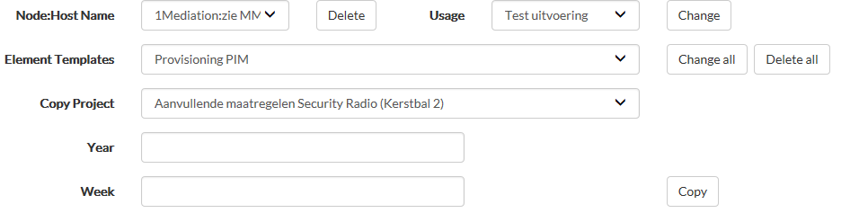
Edit element plan (2)
Now you can edit your used node (elements), for this period.
It’s possible to add the node: Host Name one by one, use a element template or you can copy from an other project.

Slide 34
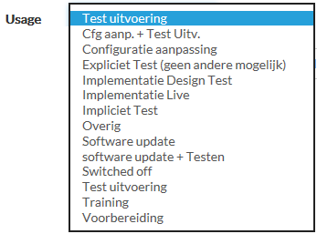
Edit element plan (3)
Edit, delete Node: Host Name
To add or delete a node: host name (element) from your project, you can select the node via the pull down menu.
Select your node: host name, then select usage.
Then you can add this element to click on change or delete it to click on delete.

Slide 35
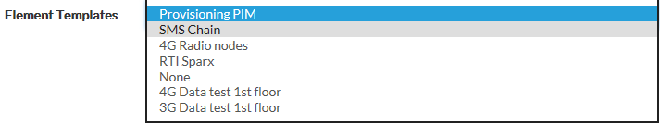
Edit element plan (4)
Edit, delete element template
Add or delete an element template for your project.
Select a element template that you want to add or remove.
Then you can add this element to click on change all or delete all to click on delete.

Slide 36
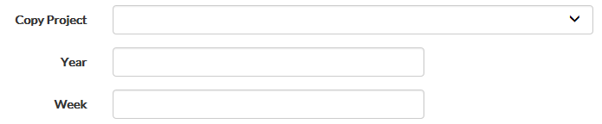

Edit element plan (4)
Copy project
It’s also possible to copy all registered elements (node) from a other project.
Select the other project (pulldown menu), and fill in year and week were you want to copy from and click on Copy.

Slide 37
Resource allocation (1)
Only the resource manager, admin and the test manager for his own project can change this.
If you want to allocate the resources, you have to go to your project via project & maintenance. And select a project.
To add your Edit Human Allocation Plan, select from week to week and select type Human Allocation in project plan. Click on edit.

Slide 38
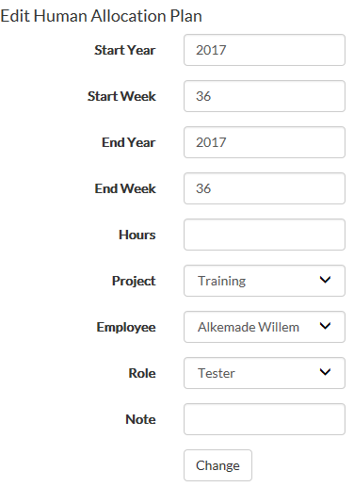

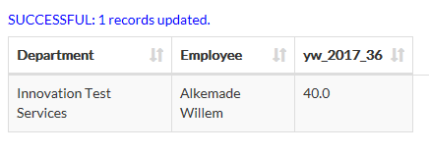
Resource allocation (2)
Edit Human Allocation Plan
In the edit human allocation plan we can change, start week and or end week if needed. Fill in the hours that the employee has to be allocated to this project.
Then select the project, employee and role
If everything is filled in correctly click on change
At the bottom you can see if this change was
successful
If you want to delete the hours, please fill in 0 hours
and click on change again.
Remarks: if you want add extra hours to this project,
be alert to change the employee name all the time.

Slide 39

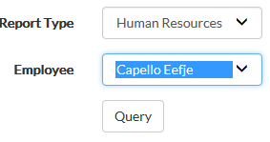

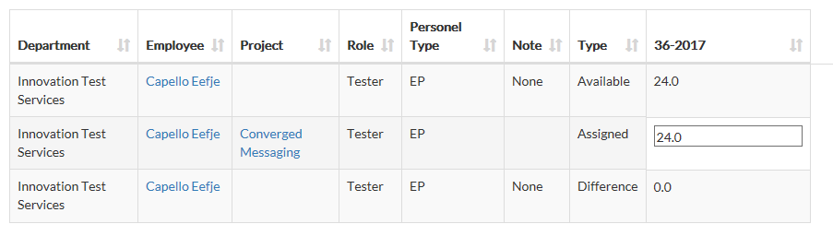


Change Resource allocation
Only the resource manager and admin can change the resource allocation
To change the resource allocation for an employee, it’s possible to change this via the report menu, fill in the start date and end date, report type Human Resources and the employee name that you want to change to allocated project hours.
Click on query and on edit now
you can change the assigned hours.
You can change the hours, to check if you filled in the changes correctly click on
Calculate if it’s correctly filled in click on save.

Slide 40

Add/Change/Delete a user account
All the users can view the information of any user account, but only admin and human_admin can add/change/delete the user account.
When you login as a user (neither admin or human_admin), and click on Users in the navigation bar, all the user accounts are shown. When you scroll down to the bottom, you can see the button New without highlight. That means you cannot add a new user account.

Slide 41

Add/Change/Delete a user account
When you login as admin or human_admin, and click the button New, you are requested to fill in the items as following. After filling in all the items required, then click the button Add, a new user account will be added to the system.

Slide 42

Add/Change/Delete a user account
When you login as a user (neither admin or human_admin), and click one of the user account. Then you will view the detailed information as following. But at the bottom, you will see the button Change and button Delete without highlight, that means you cannot change the user’s details or delete this user account.

Slide 43

Add/Change/Delete a user account
When you login as admin or human_admin, and click one of the user account. Then you will view the detailed information as well.
And at the bottom, you will see the button Change and button Delete with highlight, that means you can change the user’s details or delete this user account.
When you change any item and click the button Change, then the user’s information will be changed in the system. You can check the result by clicking the Users on the navigation bar.
When you click the button Delete, then all the information of this account is gone and the website will automatically goes back to the user list.

Slide 44



Backlog/ sprint backlog
Jira
For iPIT we added a project in Jira.
In Jira, you can find the sprint backlog and the backlog items.
Do you have any improvement or did you found same bug, please add an backlog issue for this project. Then we can discuss them with de Product Owner and development team.
If you don’t have a Jira account, you can request this account via IAM portal

